Slide 1
Database Services to Mobile Applications
Broadcast-based database services
  Data are broadcast on a public wireless channel
  When a mobile device receives a query from its user, it “tunes” into the broadcast channel and “filters” out the data requested by the query
  Updates are still sent to the server on-demand
  Scalable
    Response time vs. tuning time
  Caching on mobile devices and invalidation protocols
  Mobile transactions

Slide 2
Performance Metrics in Data Services: Response Time vs. Tuning Time
Response time (access time): Average time elapsed from the moment a client requests for a data item to the receipt of the value of the data item
Tuning time: The amount of time the mobile device is powered-on
  For broadcast-based data services, this is the amount of “connection time” spent by the mobile device listening to the broadcast channel and retrieving the data item
  When the server’s broadcast structure (e.g., indexing in air) is known to mobile devices, it is possible for a mobile device to go to “doze” mode and then only “wake-up” at the right time to retrieve the data item requested by the user
Response time = Tuning time if the mobile device is always on
Minimizing the tuning time is important for conserving the battery life of mobile devices

Slide 3
Approaches of providing database services to mobile applications
Broadcast-based data services
  Server broadcast program: flat versus broadcast disk
  Indexing in air
  Caching and cache invalidation strategies
  Support for transaction executions
    Transactional semantics
    Support for read-only transactions
    Support for update transactions

Slide 4
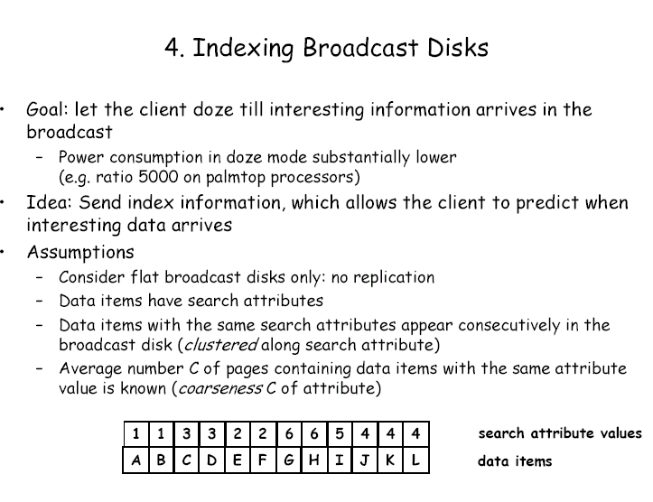

Slide 5
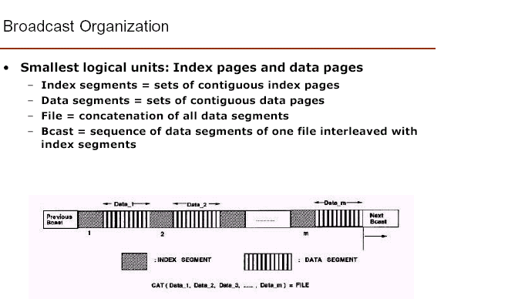

Slide 6
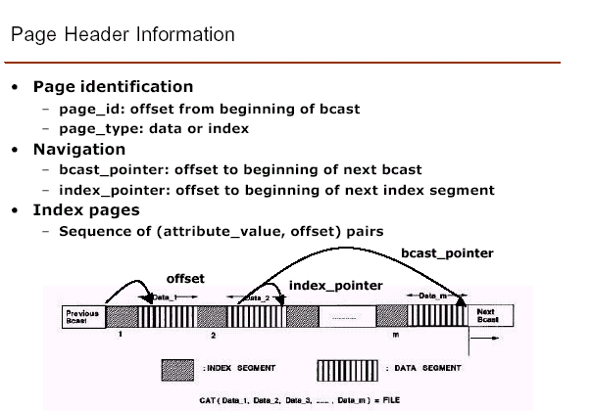

Slide 7
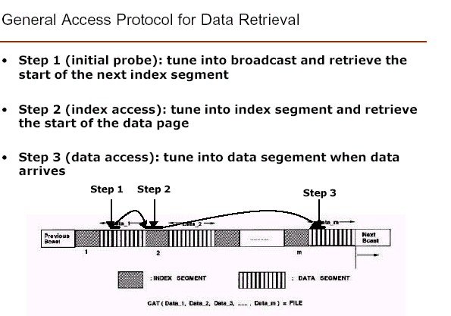

Slide 8
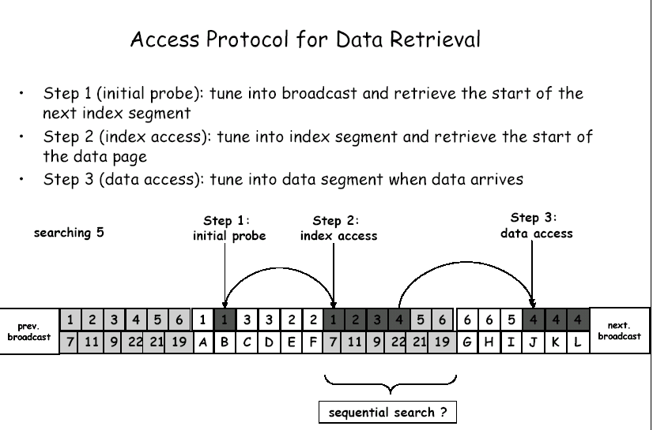

Slide 9
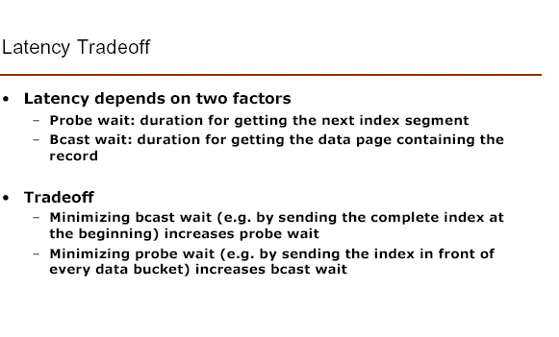

Slide 10
Parameter of Concern
Channel
Tuning time :
T1 + T2 + T3 + … + Tn
Latency:
Tn - T1
T1
Client
T2
T3
Tn

Slide 11
Parameters of concern
Tuning Time: The amount of time spent by a client listening to the channel. This determines the power used by the client to get the data.
Latency: The time elapsed from the time a client requests data to the point when all the required data is downloaded.

Slide 12
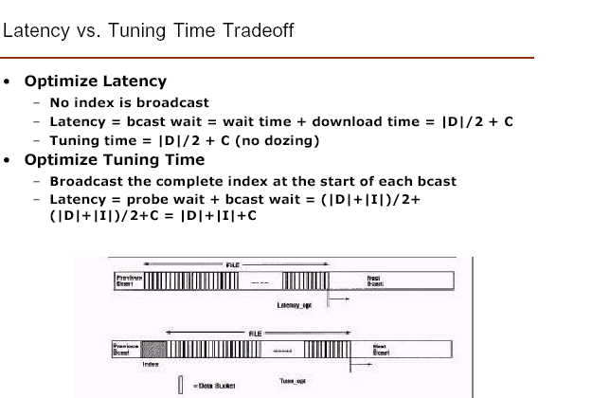
Notes:
Minimum latency – when no index
Minimum tuning time – with index
This time includes time to access index plus time to access data
This will however increase latency as we have to wait for index to arrive before we can access data.

Slide 13
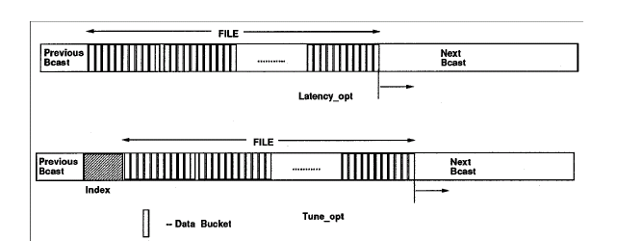

Slide 14
(1, m) Indexing
Data 1
Data 2
Data m
Tune
in
Next
Index
Pointer
Continuous
Retrieving
Client
Active
Client
Doze
Client
Active
Client
Doze
Client
Active

Slide 15
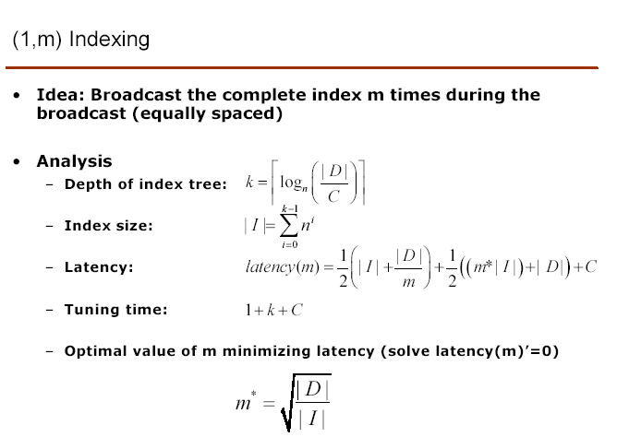
n is the capacity of the bucket, how many pair of (attribute value, offset) it can hold
No. of buckets in the index tree
bwait
pwait
Notes:
Number of times an index segment is included equally spaced
If D = I, m =1, only once index need to be broadcasted. If m =2, then data segments should be at least 4 times larger than index segment.

Slide 16
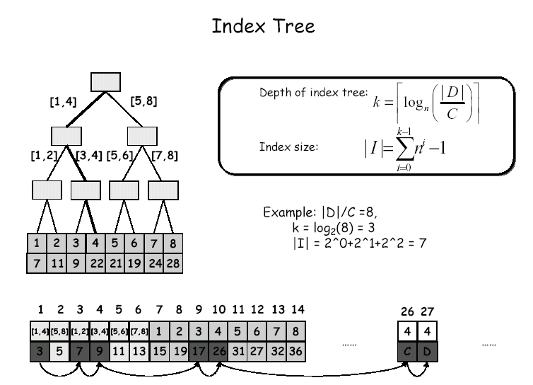
Notes:
Find root first then tune the index at first level, and then to second level and traverse the subtree from left-to-right till it finds the corresponding interval. This will take as many steps as fanout = 2 in this example. The number of searching steps is O(logN), where N is the number of data items

Slide 17
Distributed Index
No need to replicate entire index between successive data segments
Broadcast relevant index before the data segments which follows it
Non-replicated distribution – index segments are disjoint
Entire Path Replication
Partial Path Replication

Slide 18
Comparison
Nonreplicated Distribution
Full Path Replication
Partial Path Replication (Distributed Indexing)

Slide 19
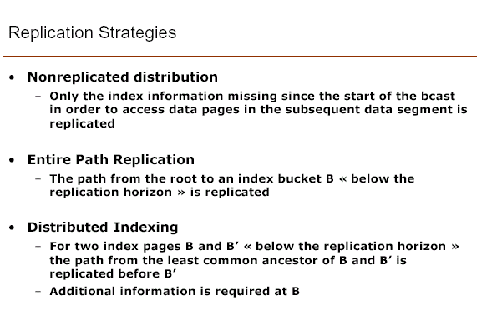

Slide 20
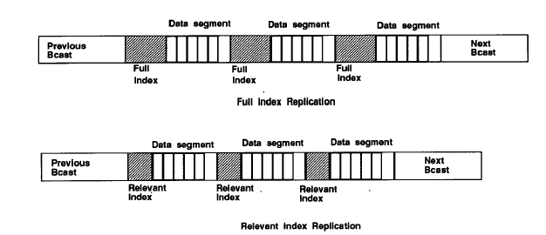

Slide 21
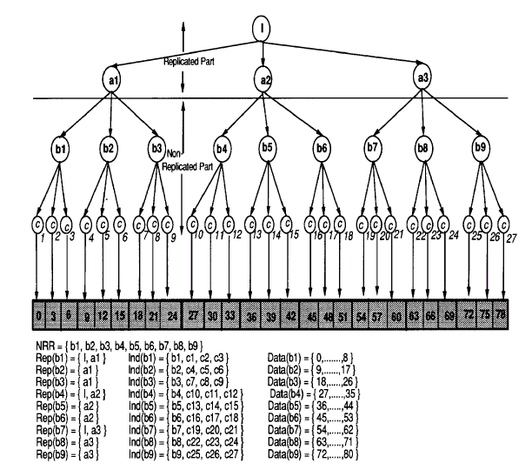
Notes:
Total 81 data buckets, each bucket at bottom level represents a collection of 3 data buckets.
Each bucket has pointer to 3 items. Index tree is shown above buckets.
Bcast consists of 3 levels, shaded portion are data buckets.

Slide 22
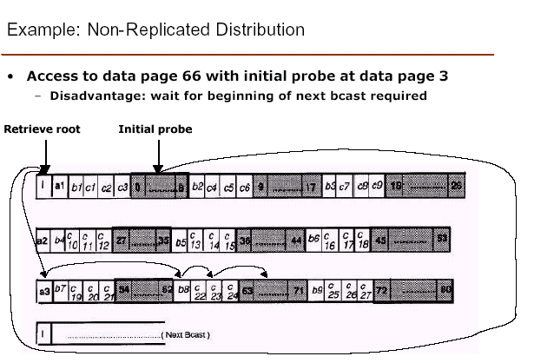
Notes:
Bcast_pointer at bucket 3 will point to the beginning of next bcast.
Thus, Bucket at 3 will point to next bcast then make successive probes I, a3, b8, c23, and bucket 66
Root is broadcasted only once , probe wait will be higher and will offset saving in bcast wait due to the lack of replication

Slide 23
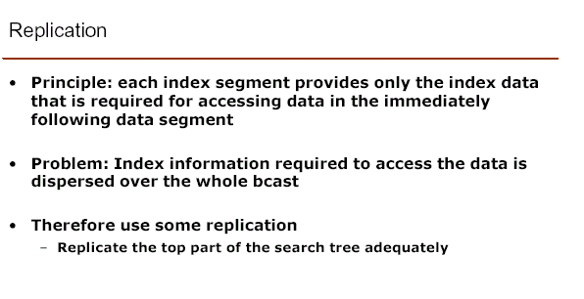

Slide 24
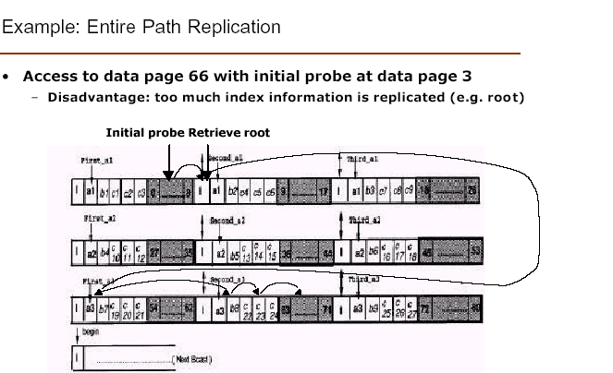
Notes:
Entire path from root of the index tree to each index bucket bi is replicated. Offset at data bucket 3 will direct the client to bucket I, then first-a3, b8, c23, bucket 66
Latency suffer from the replication of index information, I is replicated six times.

Slide 25
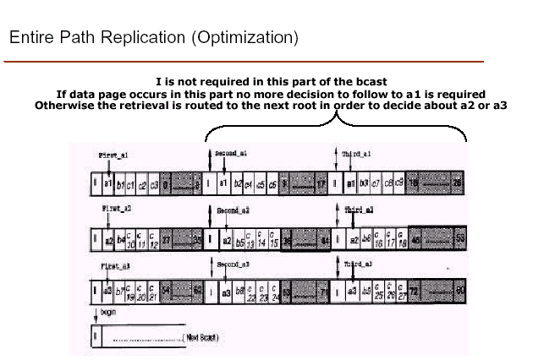
Notes:
The off-set at the data bucket 3 will direct to second a1. To make up for I, we can have a control index within second a1. If the local index in second a1 does not have a branch that would lead to the required record, then the control index can be used.
The control index will directs the clients to i2. At I2, the root is available. So then first-a3, b8, c23, bucket 66.
If 11 is searched, then second-a1 will point to b2, c4, and 11, in this case having root I before second a-1 is a waste.

Slide 26
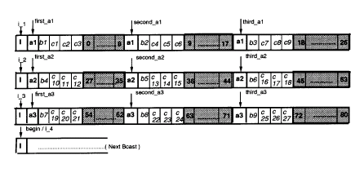

Slide 27
Control Index at Second-a1
8 | Begin
26 | I2

Slide 28
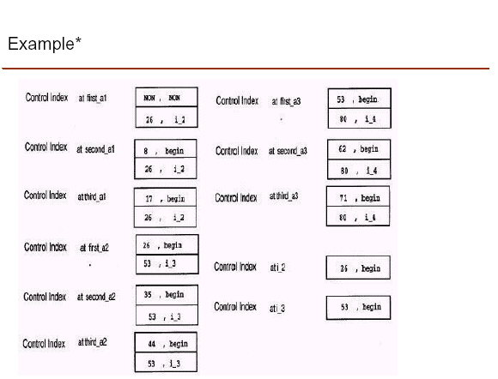
Notes:
First part in the control index denotes the search key to be compared with. Second part denotes the pointer to be followed in case comparison turns out to be positive. For example, if bucket <= 8 is being searched, then control-index second-a1 directs clients to the beginning of bcast. If record in bucket is > 26 then the search is directed to i2.

Slide 29
